Slide 1
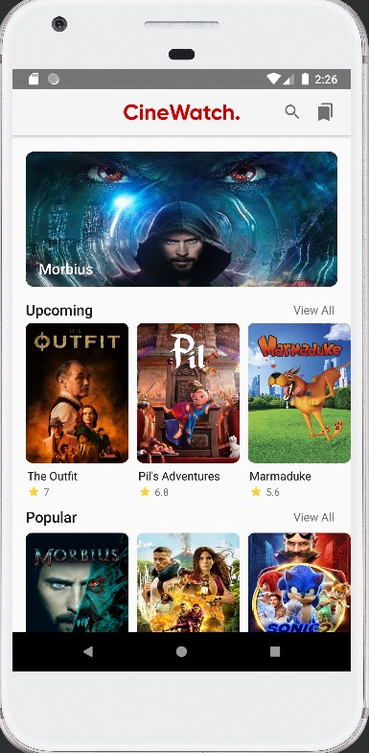
Movies app
Eng. Ahmed Tawifq
Team members:
Taha Youssef Mohamed.
Nayera Wael Ahmed.
Yomna Ahmed Fawzy.
Mohammed Mohammed Ashraf

Slide 2
Objective of the app:
User search for variety kinds of films.
Searching for information about each film and cast members, trailer of the film.
This application help user to find these required information.

Slide 3
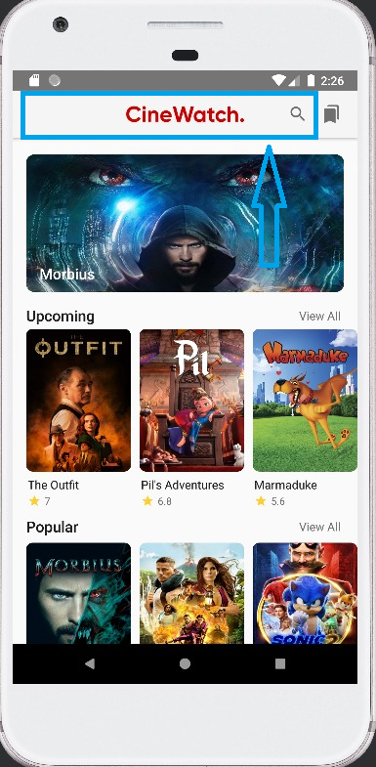
Features of the app:
This app consists of many features for example:
1. Search engine to search for a desired film.

Slide 4
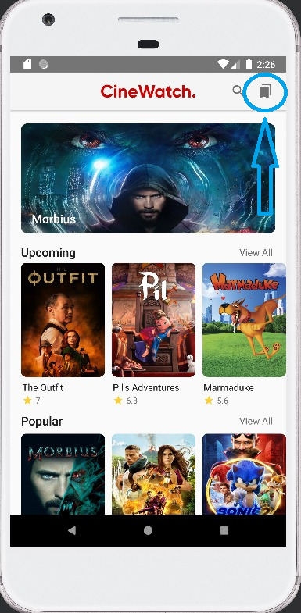
Features of the app:
2. Bookmark to save favorite films.

Slide 5
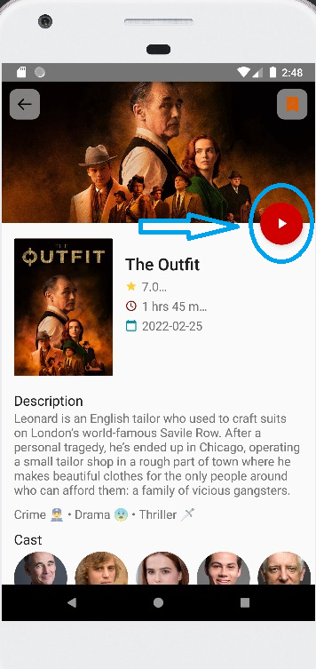
Features of the app:
3. YouTube video for watching trailer of the film

Slide 6
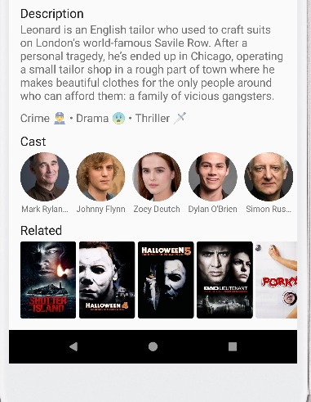
Features of the app:
4. Each film has its own description and cast to help user learn more about the desired file.

Slide 7
THANK YOU!

